Slide 1
Handling Databases with PHP

Slide 2
Objectives
Describe Database APIs
Explain the process of connecting to a database
Explain the use of data access functions
Explain SQL queries using PHP
Explain HTML tables using SQL queries

Slide 3
Introduction
Relational Database Management System (RDBMS):
 Stores data in tables that are linked with common fields, known as keys
 MS Access, Oracle, and MySQL are the different types of RDBMS
In the Linux operating system, MySQL is mostly preferred because it is an open source software, and is easy to use

Slide 4
Database APIs 1-2
Database APIs allows developers to write applications that are movable or easily accessible between the database products
Some of the common database APIs are:
 Native-Interface
 Open Database Connectivity (ODBC)
 Java Database Connectivity (JDBC)
 Common Object Request Broker Architecture (CORBA)

Slide 5
Database APIs 2-2
PHP supports MySQL database for accessing data from the database
 Connecting to a Database
 A Web site connects to a database to access and store information
 Steps for connecting to a database are as follows:
Open the database connection
Work with the database
Close the database connection

Slide 6
Connecting to the MySQL Server
PHP and MySQL are automatically installed while customizing the installation of Linux operating system
A connection needs to be establish to the MySQL server and PHP with the help of mysql_connect()function
This function takes three arguments:
 Name of the machine on which the database is running
 Database username
 Database user password

Slide 7
Connecting to the MySQL Server
2-3
Connecting to the MySQL server is as follows:
Syntax
$link_id = mysql_connect("host_name","user_name","password");
Where,
host_name - specifies the name of the server on which the database is running. The default location of MySQL server is localhost
user_name - specifies the username
password - specifies the password to connect to the database
link_id - stores the return value of the connection

Slide 8
Connecting to the MySQL Server
3-3
mysql.php - Connecting to the MySQL server
Snippet
<?php
$link_id mysql_connect("localhost","root","abc123");
?>
In the code,
root is the username. localhost is the server name. abc123 is the password.

Slide 9
Working with the Database 1-11
Before starting work with the database, a connection needs to be established with the MySQL server
PHP provides the following functions to work with the MySQL database:
 mysql_list_dbs()- This function displays all the databases available on the server
The mysql_list_dbs()function is as follows:
Syntax
mysql_list_dbs($link_id);
where,
link_id - specifies the return value of the connection

Slide 10
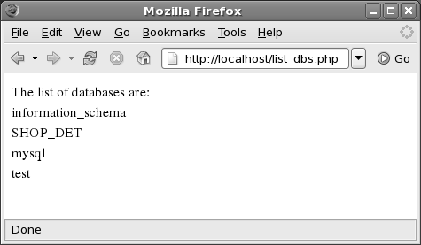
Working with the Database 2-11
list_dbs.php – Displaying all the databases present on the server
Snippet
<?php
$connect = mysql_connect('localhost', 'root', '');
$db_list = mysql_list_dbs($connect); echo "The list of databases are:<br>";
while ($row = mysql_fetch_object($db_list))
{
echo $row->Database . "<br>";
}
?>
Displays the output:
Displays the list of the databases that are present in the instance of MySQL.

Slide 11
Working with the Database 3-11
 mysql_select_db()- This function defines the database that will be used for the connection
The mysql_select_db()function is as follows:
Syntax
mysql_select_db("database_name", $link_id);
Where,
database_name - specifies the database name
link_id - specifies the return value of the connection

Slide 12
Working with the Database 4-11
 mysql_select_db.php - Connecting to the MySQL database
Snippet
<?php
$server = "";
$username = "root";
$password = "";
$connect_mysql = mysql_connect($server, $username, $password);
$mysql_db = mysql_select_db("mysql", $connect_mysql);
if(!$mysql_db)
{
die("Connection failed");
}
else
{
echo "Current Database is selected";
}
?>

Slide 13
Working with the Database 5-11
 mysql_list_tables()- This function displays a list of all the tables available in the specified database
The mysql_list_tables()function is as follows:
Syntax
mysql_list_tables("database_name", $link_id);
Where,
database_name - specifies the database name
link_id - specifies the return value of the connection

Slide 14
Working with the Database
6-11
 listables.php - To list all the tables of the MySQL database
Snippet
<?php
$dbname = 'mysql';
if (!mysql_connect('127.0.0.1', 'root', ''))
{
echo 'Could not connect to mysql';
exit;
}
$sql = "SHOW TABLES FROM $dbname";
$result = mysql_query($sql);
echo " The tables from the database are: <br><br>";

Slide 15
Working with the Database
7-11
if (!$result)
$result = mysql_query($sql);
echo " The tables from the database are: <br><br>"; if (!$result)
{
echo "DB Error, Unable to list tables<br>";
echo 'MySQL Error: ' . mysql_error(); exit;
}
while ($row = mysql_fetch_row($result))
{
echo "Table: {$row[0]}<br>";
}
?>

Slide 16
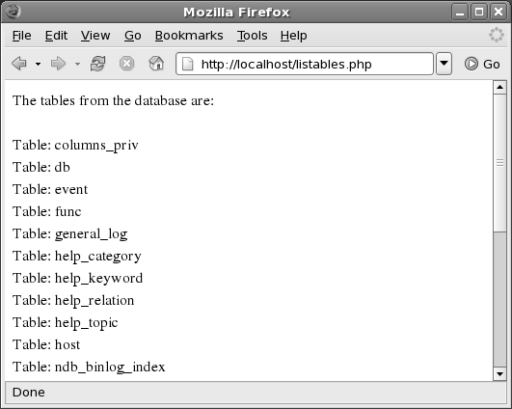
Working with the Database
8-11
Displays the following output:
All the tables available in the mysql database are
listed and stored in the $result variable.

Slide 17
Working with the Database 9-11
 mysql_num_rows()- This function displays the number of rows present in the specified table
The mysql_num_rows()function is as follows:
Syntax
mysql_num_rows("table_name");
Where,
table_name - specifies the name of the table for displaying the number of rows

Slide 18
Working with the Database 10-11
 list_rows.php - Listing the number of rows from a table in a database
Snippet
<?php
$connect = mysql_connect("localhost", "root", ""); mysql_select_db("mysql", $connect);
$result = mysql_query("SELECT * FROM user", $connect);
$rows = mysql_num_rows($result);
echo "The table contains $rows rows.<br>";
?>

Slide 19
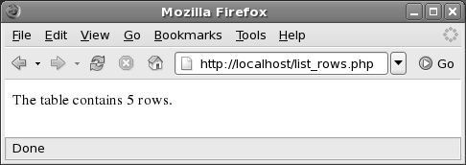
Working with the Database
11-11
Displays the following output:
The number of rows from the table are listed.

Slide 20
Closing the Connection 1-3
The connection with MySQL server can be closed with the help of the mysql_close()function
The mysql_close()function is as follows:
Syntax
mysql_close($link_id);
Where,
link_id - specifies the return value of the connection

Slide 21
Closing the Connection 2-3
conn_close.php - Closing the connection to the MySQL database
Snippet
<?php
$connect = mysql_connect("localhost", "root", ""); mysql_select_db("mysql", $connect);
$result = mysql_query("SELECT * FROM user", $connect);
$rows = mysql_num_rows($result);
echo "The table contains $rows rows.<br><br>"; mysql_close($connect);
echo "The connection to the database has been closed.";
?>

Slide 22
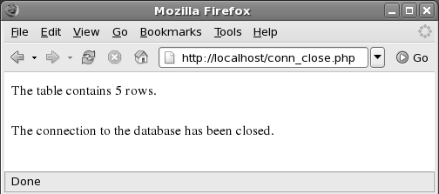
Closing the Connection 3-3
Displays the following output:

Slide 23
Data Access Functions 1-4
PHP provides the following functions for accessing data from the database:
 mysql_query()- Executes MySQL query for retrieving data from tables and commands such as SELECT, SHOW, EXPLAIN, and DESCRIBE can be used with this function
The mysql_query()function is as follows:
Syntax
mysql_query(query, link_id);
Where,
query - specifies the MySQL query
link_id - specifies the return value of the connection

Slide 24
Data Access Functions 2-4
 mysql_fetch_array()- Retrieves the rows of the table and saves it as an array. It is an extended version of mysql_fetch_row() function
The mysql_fetch_array()function is as follows:
Syntax
Syntax
mysql_fetch_array("table_name");
mysql_fetch_row("table_name");
Where,
table_name - specifies the name of the selected table

Slide 25
Data Access Functions 3-4
 mysql_field_len()- Displays the length of the specified field
The mysql_field_len()function is as follows:
Syntax
mysql_field_len("table_name", "field_name");
Where,
table_name - specifies the table name
field_name - specifies the field name for which the length needs to be displayed

Slide 26
Data Access Functions 4-4
 mysql_num_fields()- Displays the number of fields in the specified table
The mysql_num_fields()function is as follows:
Syntax
mysql_num_fields("table_name");
Where,
table_name - specifies the table name

Slide 27
Executing SQL Queries in PHP 1-18
Before executing the SQL queries in PHP, a database connection must be established
Create a table named USER_CONTACT in the USER
database with the fields as shown in table
Field Name | Data Type | Constraint
USER_ID | INT | NOT NULL PRIMARY KEY
USER_NAME | CHAR(25) | NOT NULL
USER_EMAIL_ID | CHAR(25)

Slide 28
Executing SQL Queries in PHP 2-18
mysqltable.php - To create a table using SQL commands in PHP
Snippet
<?php
$server = "";
$username = "root";
$password = "";
$connect_mysql = mysql_connect($server, $username, $password); if($connect_mysql)
{
echo "Connection established<BR>";
}
else
{
die("Unable to connect to the database<BR>");
}
$sql_table = "CREATE TABLE USER_CONTACT("."USER_ID INT NOT NULL PRIMARY KEY, "."USER_NAME CHAR(25) NOT NULL, "."USER_EMAIL_ID CHAR(25)".")";
if(mysql_query($sql_table))
{
echo "Table is created<BR>";
}

Slide 29
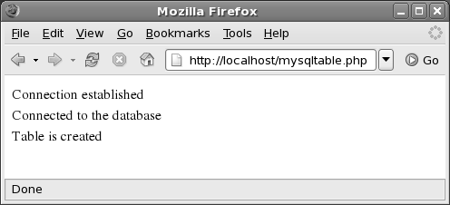
Executing SQL Queries in PHP
3-18
else
{
die("Unable to create the table<BR>");
}
?>
Displays the following output:
The USER_CONTACT table is created in the USER database.

Slide 30
Executing SQL Queries in PHP 4-18
In the code, the USER_CONTACT table is created in the USER database
The table is created using the CREATE command in MySQL
The records in the table are inserted with the HTML FORM
method

Slide 31
Executing SQL Queries in PHP 5-18
usercontact.php - Inserting records in the USER_CONTACT
table
Snippet
<?php
$server = "";
$username = "root";
$password = "";
$connect_mysql = mysql_connect($server, |  | $username,
$password);
if($connect_mysql)
{
echo "Connection established.";
}
else
{
die("Unable to connect");

Slide 32
Executing SQL Queries in PHP 6-18
}
$db = "user";
$mysql_db = mysql_select_db($db); if($mysql_db)
{
echo "<BR><BR>Connected to the database.";
}
else
{
die("Unable to connect to the database");
}
$sql_insert = "INSERT INTO user_contact (user_id, user_name, user_email_id)
VALUES (101,'John','john@mail.com')";
$result = mysql_query($sql_insert);

Slide 33
Executing SQL Queries in PHP 7-18
if($result)
{
echo "<BR><BR>The records have been added to the table.";
}
else
{
echo "Unable to insert records.";
mysql_error();
}
?>

Slide 34
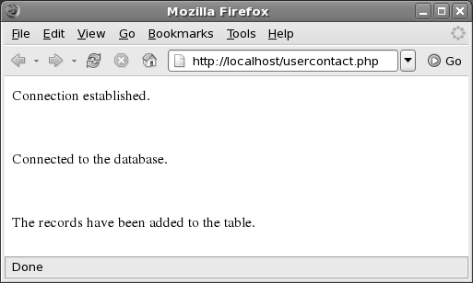
Executing SQL Queries in PHP
8-18
Displays the following output:
Records are inserted in the table using the INSERT command

Slide 35
Executing SQL Queries in PHP 9-18
Using the SELECT command, a data can be accessed from the tables
displaytable.php - Displaying the records of the
USER_CONTACT table from the USER database
Snippet
<?php
$server = "";
$username = "root";
$password = "";
$connect_mysql = mysql_connect($server,
$password);
$username,
if($connect_mysql)

Slide 36
Executing SQL Queries in PHP
10-18
{
echo "Connection established<br>"; } else
{
die("Unable to connect<br>");
}
//$mysqli_db
$mysql_db = mysql_select_db("USER"); if($mysql_db)
{
echo "Connected to the database<br>";
}
else
{
die("Unable to connect to the database<br>");

Slide 37
Executing SQL Queries in PHP 11-18
}
$sql_disp=("SELECT * FROM USER_CONTACT;");
echo "<br>Displaying Records from the USER_CONTACT table:<br>";
$result = mysql_query($sql_disp);
while ($row = mysql_fetch_array($result))
{
echo "$row[USER_ID] ";
echo "$row[USER_EMAIL_ID] <br>";
}
?>

Slide 38
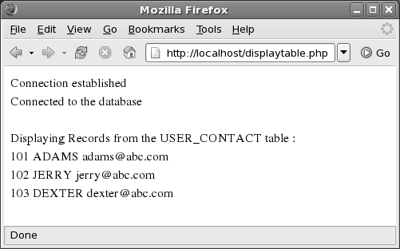
Executing SQL Queries in PHP
12-18
Displays the following output:
The records such as USER_ID, USER_NAME, and
USER_EMAIL_ID from the USER_CONTACT table are displayed

Slide 39
Executing SQL Queries in PHP 13-18
The DELETE and UPDATE commands enable to modify the contents of the table
delete_record.php - To delete a record from the table
Snippet
<?php
$server = "";
$username = "root";
$password = "";
$connect_mysql = mysql_connect($server, $username, $password); if($connect_mysql)
{
echo "Connection established<br>";
}

Slide 40
Executing SQL Queries in PHP
14-18
else
{
die("Unable to connect<br>");
}
$mysql_db = mysql_select_db("USER"); if($mysql_db)
{
echo "Connected to the database<br>";
}
else
{
die("Unable to connect to the database<br>");
}
$sql_delete = ("DELETE FROM USER_CONTACT WHERE USER_ID = '101'");
$result = mysql_query($sql_delete); if($result)
{
echo "Records Deleted: $result<br>";
}

Slide 41
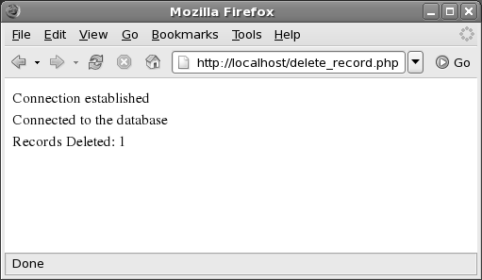
Executing SQL Queries in PHP
18-18
else
{
echo "RECORDS NOT FOUND IN THE TABLE<br>";
mysql_error();
}
?>
Displays the following output:

Slide 42
Executing SQL Queries in PHP 16-18
update_record.php - Updating a record in the table
Snippet
<?php
$server = "";
$username = "root";
$password = "";
$connect_mysql = mysql_connect($server, $username, $password);
if($connect_mysql)
{
echo "Connection established<br>";
}
else
{
die("Unable to connect<br>");
}
$mysql_db = mysql_select_db("USER"); if($mysql_db)

Slide 43
Executing SQL Queries in PHP
17-18
{
echo "Connected to the database<br>";
}
else
{
die("Unable to connect to the database<br>");
}
$sql_update=("UPDATE USER_CONTACT SET USER_NAME =’David’ WHERE USER_ID =’102’");
$result=mysql_query($sql_update);
if($result)
{
echo "RECORDS UPDATED: $result<br>";
}
else
{
echo "UNABLE TO UPDATE RECORDS<br>";
mysql_error();
}
?>

Slide 44
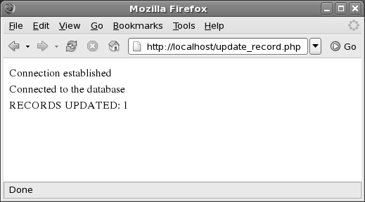
Executing SQL Queries in PHP
18-18
Displays the following output:

Slide 45
Building HTML Tables Using SQL Queries 1-4
HTML supports database application components for accessing the database
The contents of the SQL tables can be displayed on the Web
browser by building an HTML table structure

Slide 46
Building HTML Tables Using SQL Queries 2-4
display_records.php - Displaying all the records of the
user_contact
Snippet
<HTML>
<BODY>
<?php
$server = "";
$username = "root";
$password = "";
$connect_mysql = mysql_connect($server, $username, $password); if($connect_mysql)
echo "Connection established";
$mysql_db = mysql_select_db("USER"); if($mysql_db)
echo "<BR><BR>Connected to the database<BR><BR>";
echo "<TABLE BORDER BGCOLOR="WHITE">";

Slide 47
Building HTML Tables Using SQL Queries 3-4
echo "<TR><TH>USER_ID<TH><TH>USER_NAME<TH><TH>USER_EMAIL_ID </TH>";
echo "<DBQUERY q> select * FROM USER_CONTACT";
echo "<DBROW><TR><TD><? q.USER_ID></TD><TD><? q.USER_NAME></TD><TD><? q.USER_EMAIL_ID></TD></TR>";
echo "</DBQUERY>";
echo "</TR>";
echo "</TABLE>";
?>
</BODY>
</HTML>

Slide 48
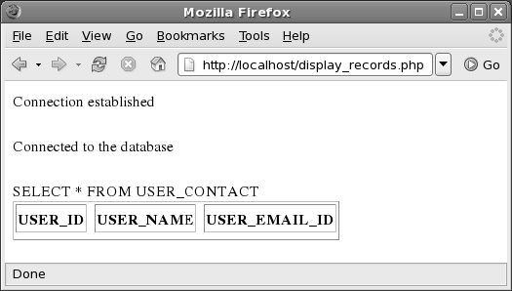
Building HTML Tables Using SQL Queries
4-4
Displays the following output:
Displays the records of the user_contact table on the Web
browser in a tabular format.

Slide 49
Summary 1-2
Database APIs enable developers to write applications that are movable or easily accessible between the database products
The common database APIs are Native-Interface, ODBC, JDBC,
and CORBA
PHP is connected to MySQL using three arguments: the MySQL server host name, the MySQL user name, and the MySQL user password
The connection with the server is established with the help of mysql_connect() function
The basic PHP functions that are used with respect to the database are: mysql_list_dbs(), mysql_select_db(), mysql_list_tables(), and mysql_num_rows()

Slide 50
Summary 2-2
The mysql_close() function closes the connection with the MySQL server
The data access functions used in PHP are: mysql_query() ,
mysql_fetch_array(),mysql_fetch_row(), mysql_fetch_field(),
mysql_field_len(), and mysql_num_fields()

